Slide 1

Image and video compression LAB Optimization
Xiajun Zhou
Zeen Song
Technische Universität München
Fakultät für Elektro -und Informationstechnik
Lehrstuhl für Medientechnik
München, 30.7.2019

Slide 2
Attempts:
▪ Another Color Space(PCA)
▪ DWT
▪ Adaptive quantization table
0,01PSNR improvement average ☹
Bad result without toolbox ☹
Even worse than before ☹
Final Decision:
▪ Deep Learning with CNN ☺

Slide 3
Outline
▪ Another Color Space(PCA)
▪ Deep Learning with CNN

Slide 4
PCA Color Space
Reference:
▪ Li, Ming, et al. "A Better Color Space Conversion Based on Learned Variances For Image Compression.“ CVPR workshops 2019.[link]

Slide 5
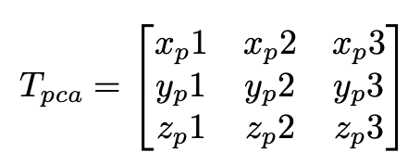
Approach:
Main idea: Principle component analyses(PCA)
1. Mean Subtract (little trick): Instead of subtracting whole images average. Whole Image will be divided into 16*16 blocks, each sample minus the average within the same grid.
2. Covariance Matrix: Define the sample as S, and ST × S is the covariance matrix COV of size 3×3.
3. Eigenvalue Decomposition: Perform EVD for the covariance matrix COV. Stack the eigenvectors along column to form transformation matrix Tpca

Slide 6
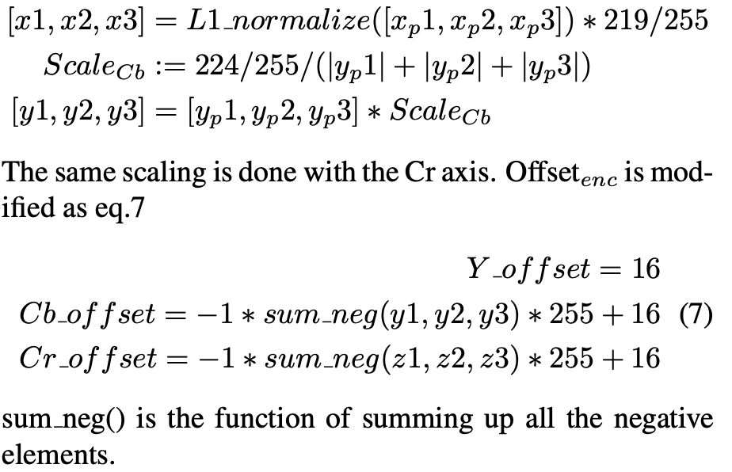
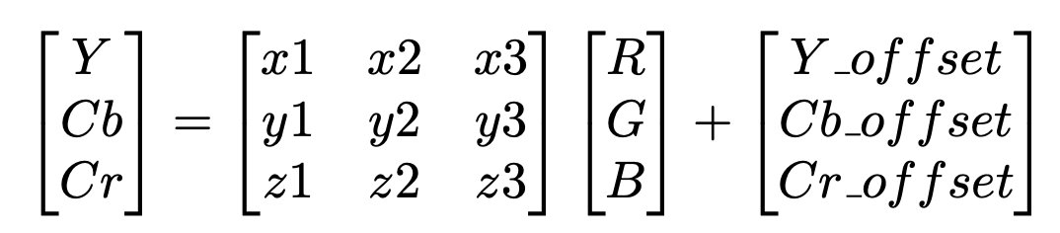
PCA Color Space

Slide 7
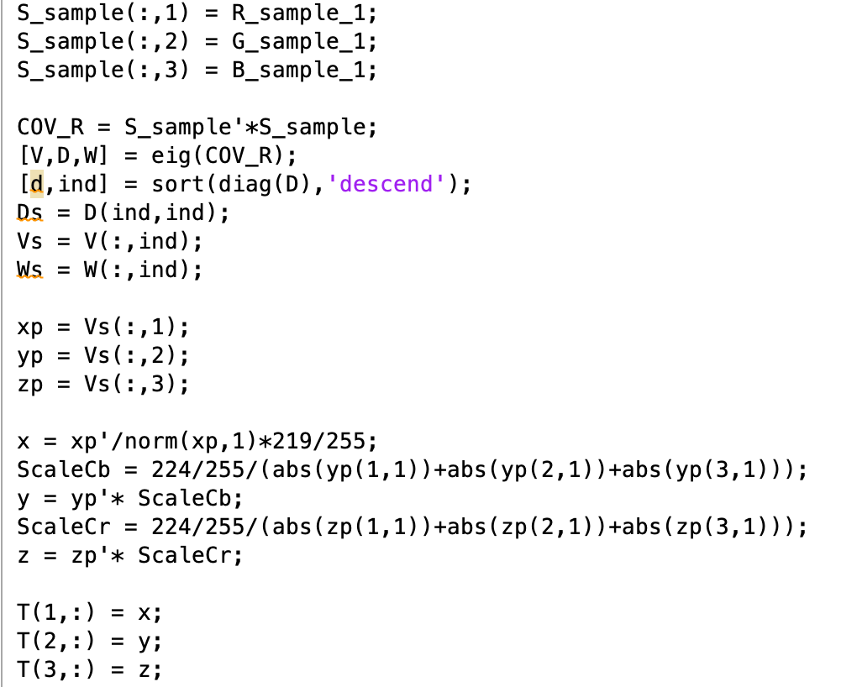
Code

Slide 8
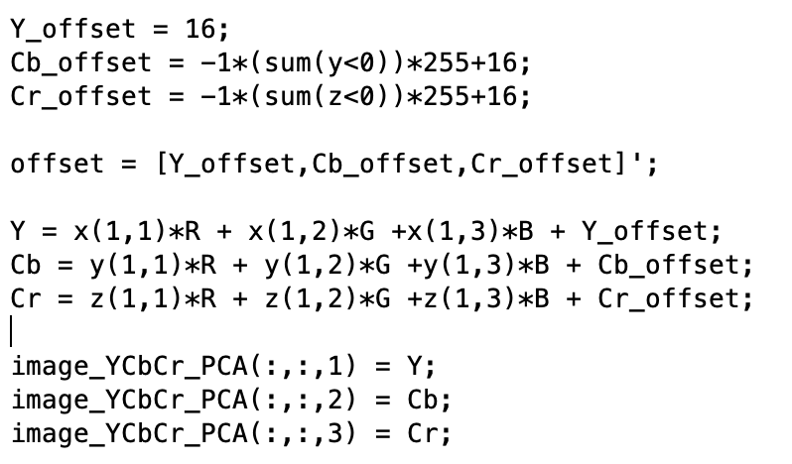
Code

Slide 9
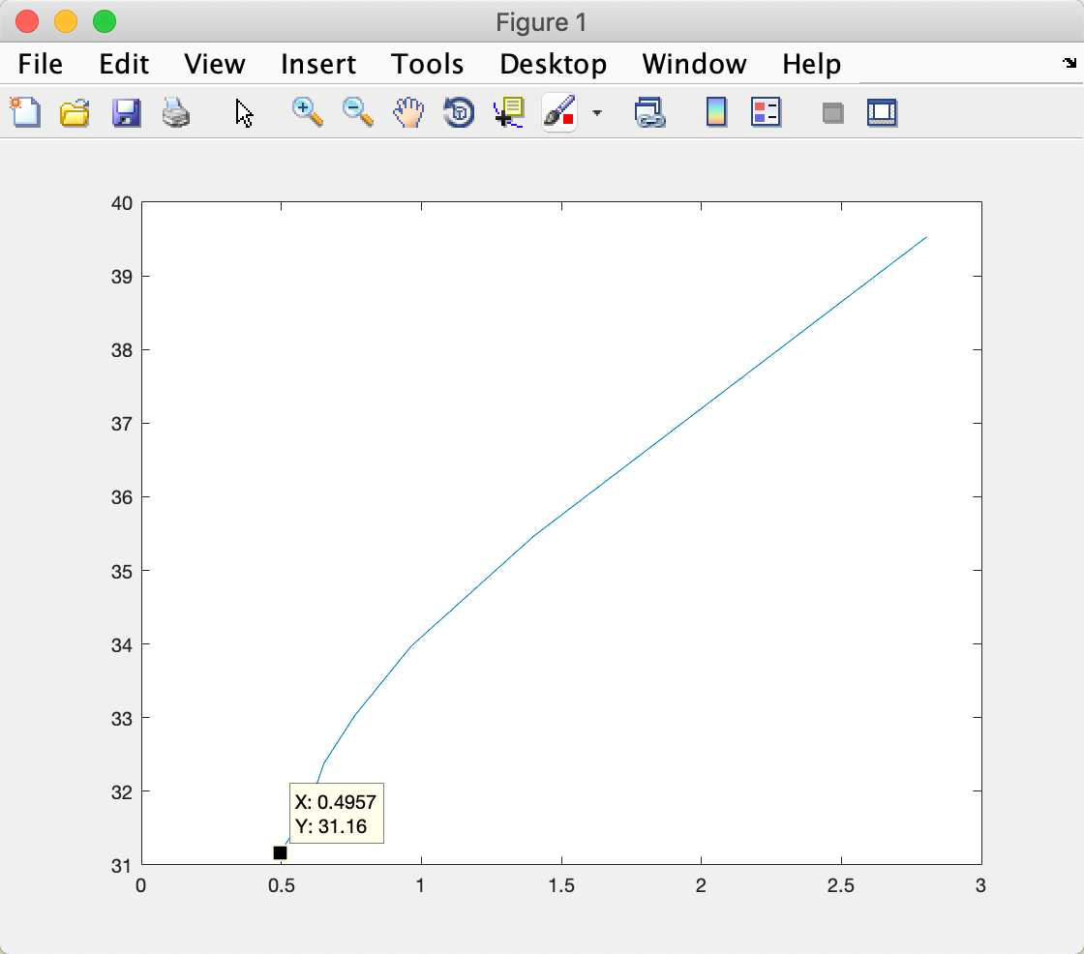
Bad Result:
Reasons:
Color Space domain not fit.
More Bitstream: less zero than before(solved by training with Lena)
Have to send a matrix for T and offset, because every picture has a unique one.

Slide 10
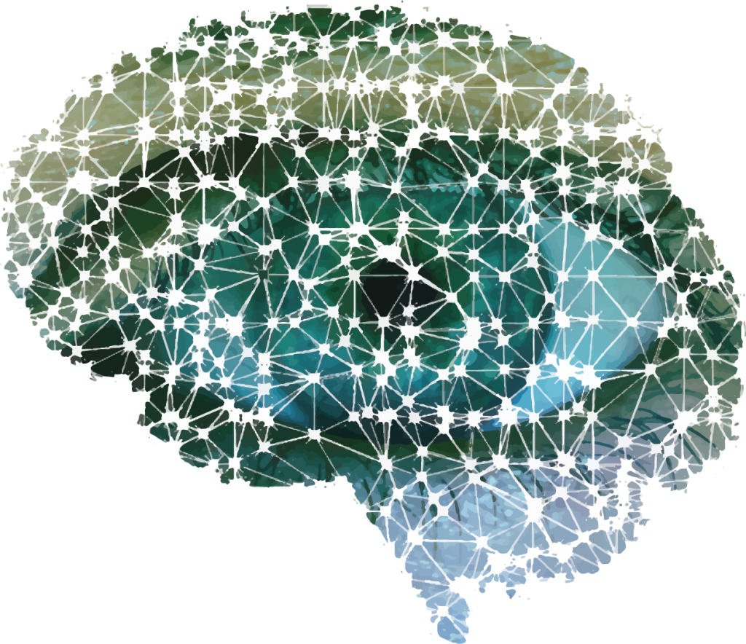

Deep Learning

Slide 11
Deep Learning Method
Reference:
▪ Chao Dong, et al. “Compression Artifacts Reduction by a Deep Convolutional Network.” ICCV 2015 [link]
▪ Pavel Svoboda, et al. “Compression Artifacts Removal Using Convolutional Neural Networks.” ICCV 2017 [link]

Slide 12
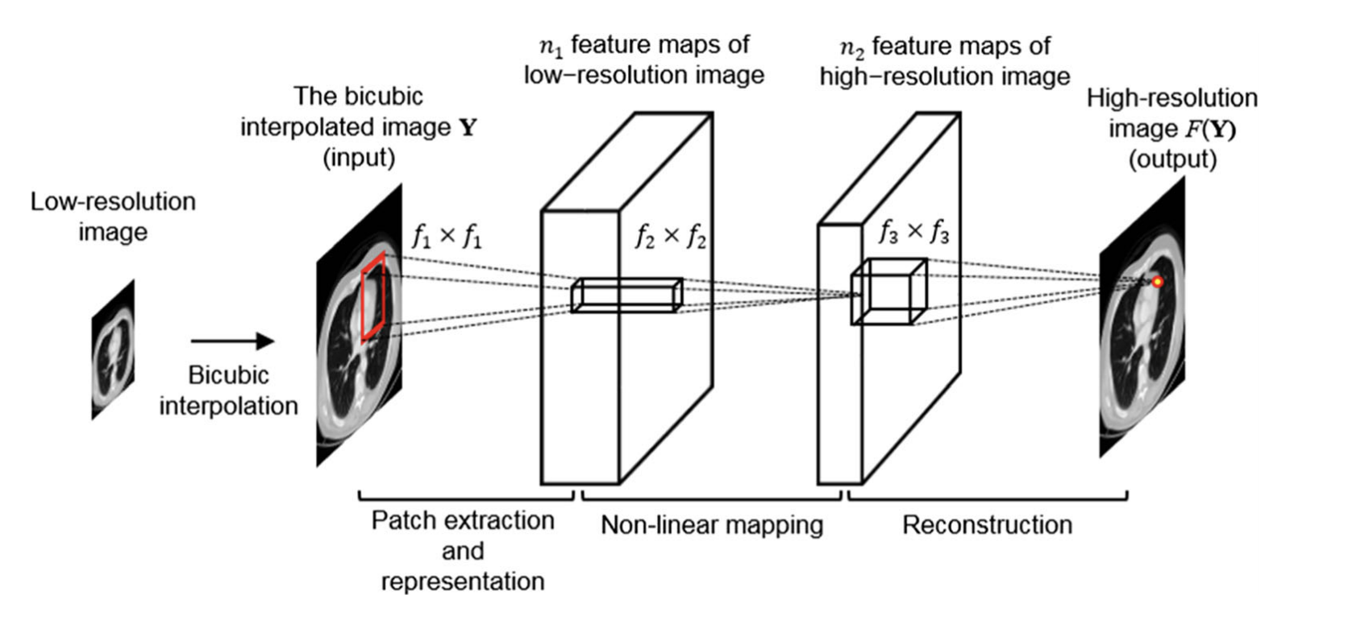
Approach
Old Type SRCNN
Idea source of ARCNN: SRCNN

Slide 13
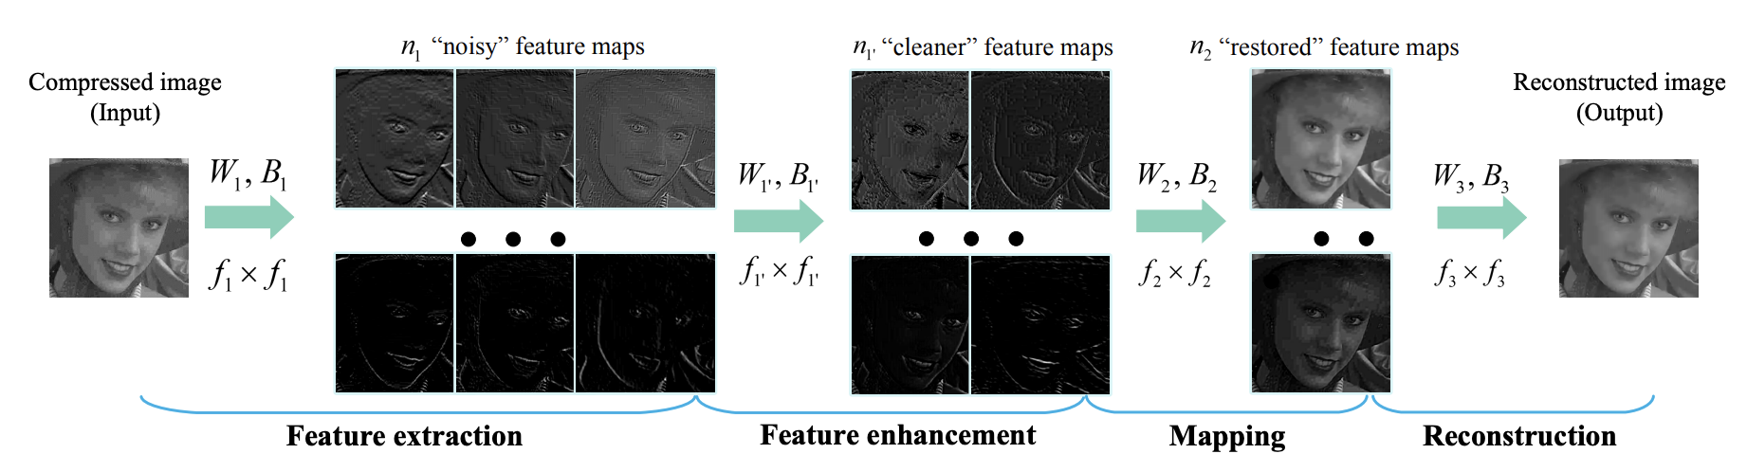
Approach
ARCNN structure offered in Paper Chao dong et al.

Slide 14
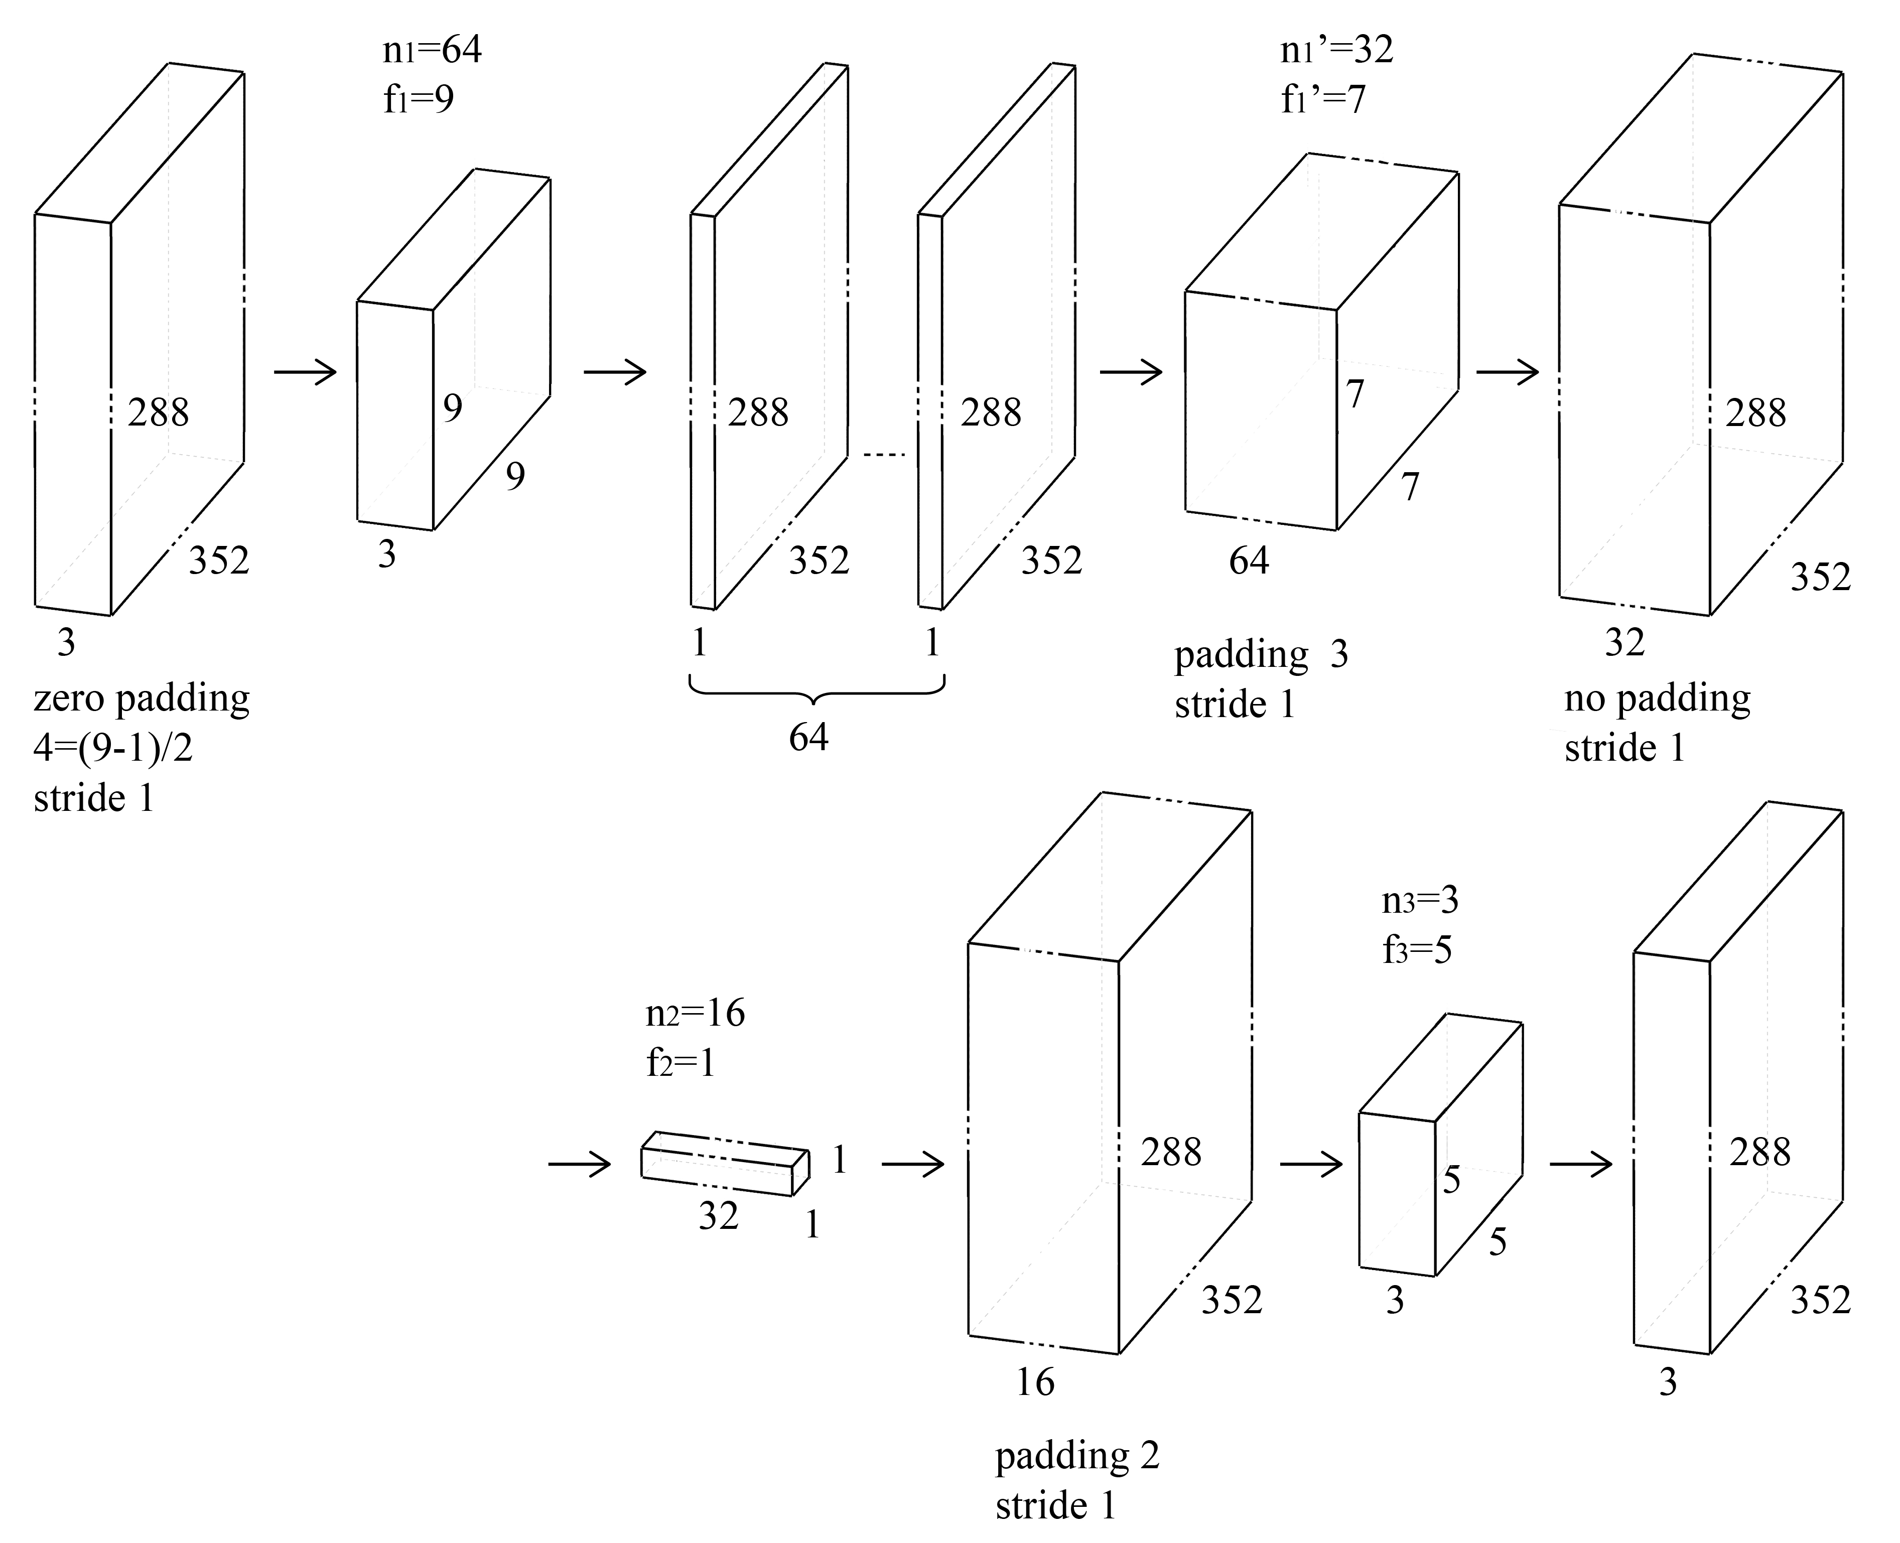
Our CNN Network Structure

Slide 15
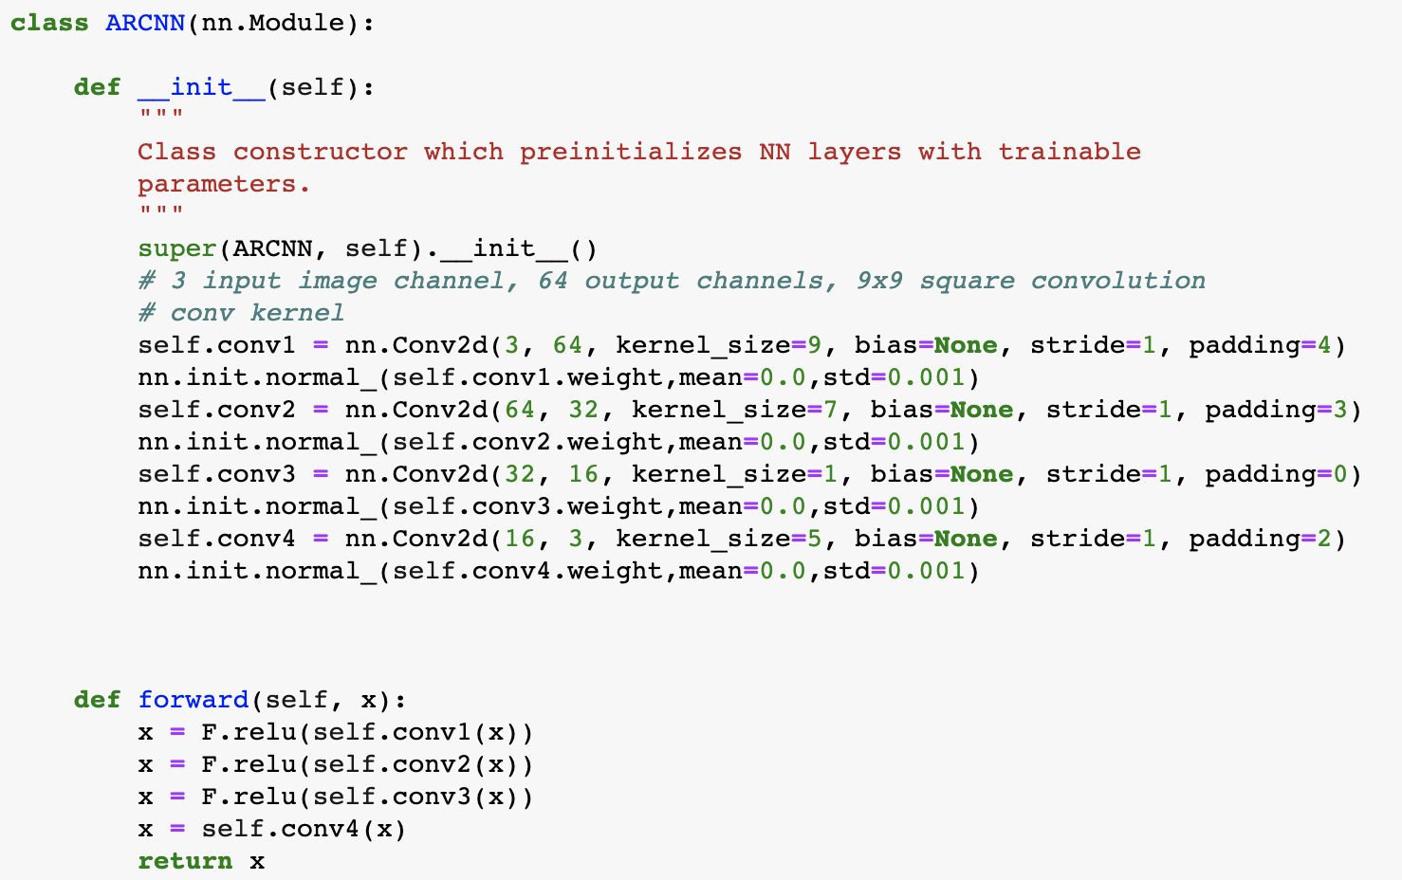
Model Code

Slide 16
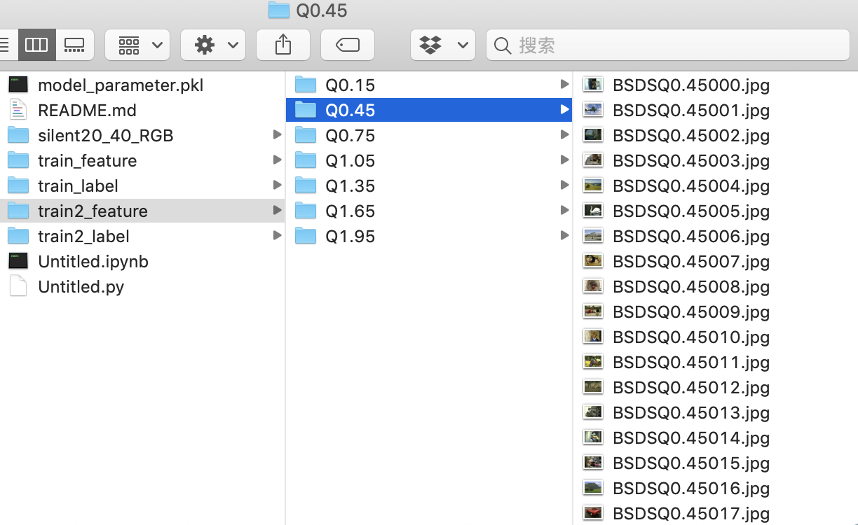
Preparation
Label data (Ground Truth):
1. Video Sequence: from LAB except foreman0020-0040 (e.g. silent and akiyo)
2. Still images: 200 images BSDS500
Training data(feature):
Put Ground Truth above into our Matlab codec programm in Lab session 5 and take qScale = 0.15:0.3:1.95. For each qScale there will be feature pictures corresponding to ground truth.

Slide 17
Data processing
From pictures to tensors, to make the data suitable for GPU
Normalize the data, to make it range from [-1,1]
Use dataloader from pytorch to train the data in batch

Slide 18
Training
First approach: use only provided sequences as training set, and train the training data with all quantization scale together.
Result: the output images have PSNR worth than the input images
Improvement: trained the data with specific order, trained the images with low quality first and gradually raise the quality.
Result: the output images have PSNR 0.1~0.4dB higher than input images
Further improvement: increasing dataset and use BSDS500 as training set.
Result: the output images have PSNR 1.3~2dB higher than the input images

Slide 19
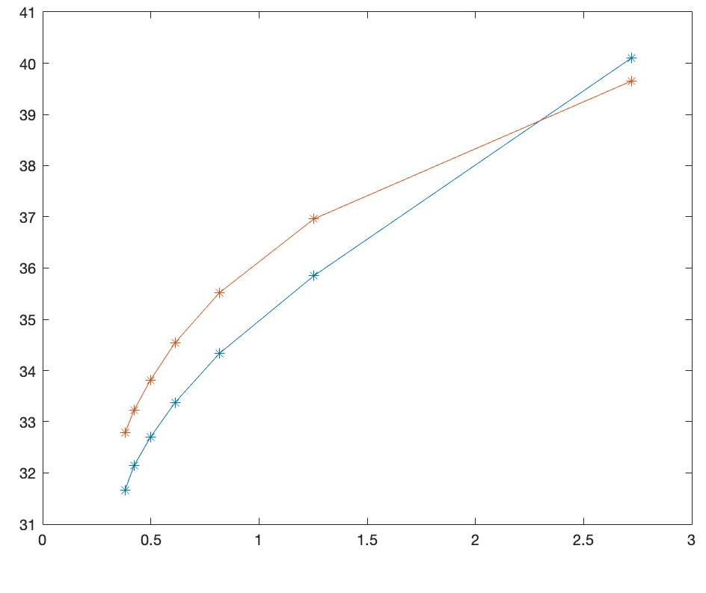
Test and Result Compare
Blue: BASELINE
Orange: ARCNN

Slide 20
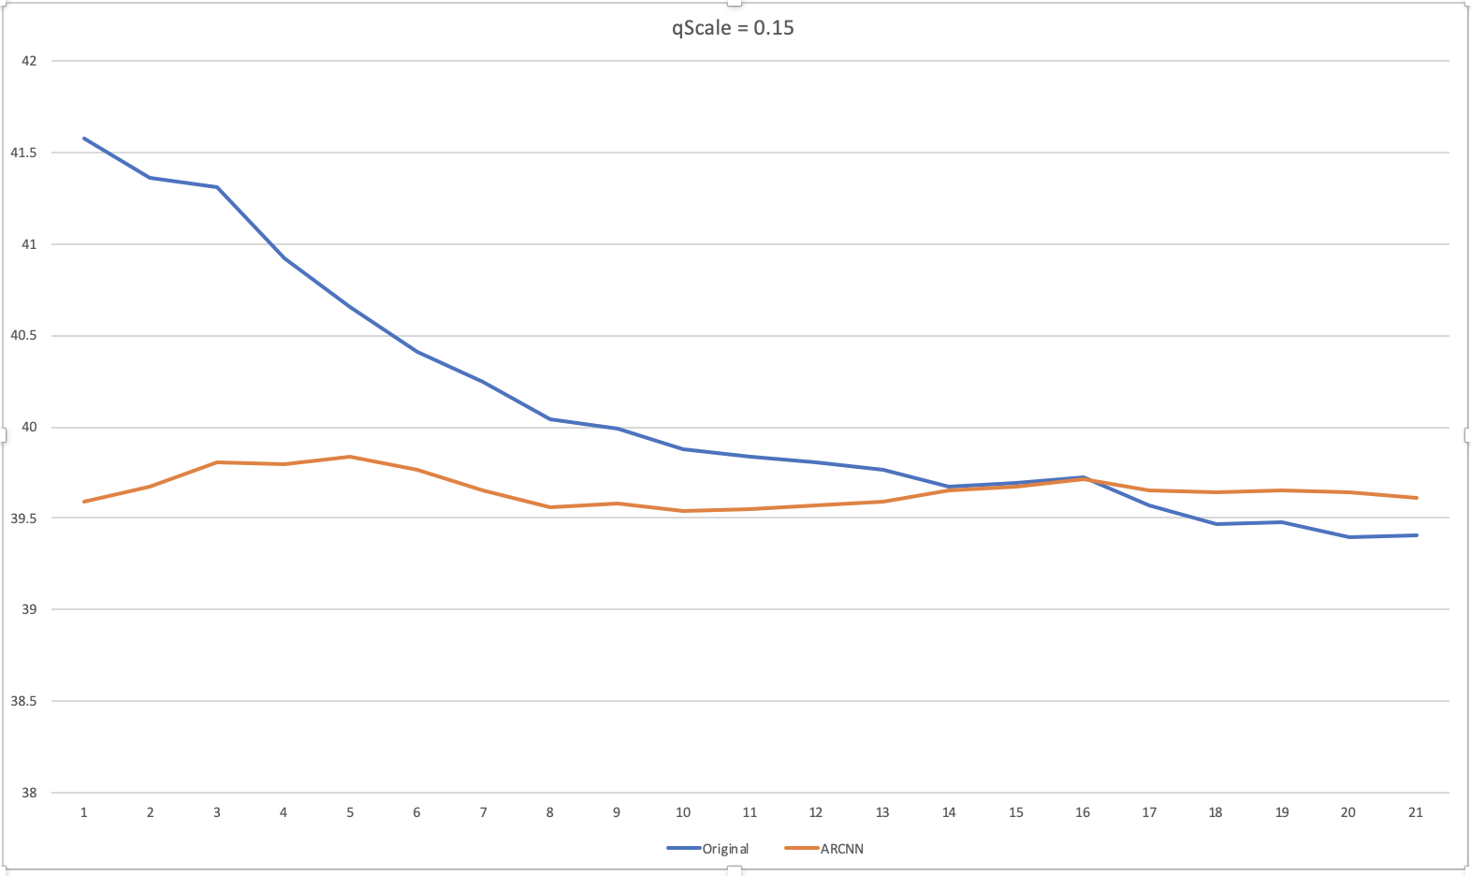
Analyses about qScale = 0.15
Original: Max-Min: 2.1757
ARCNN: Max-Min: 0.2903

Slide 21
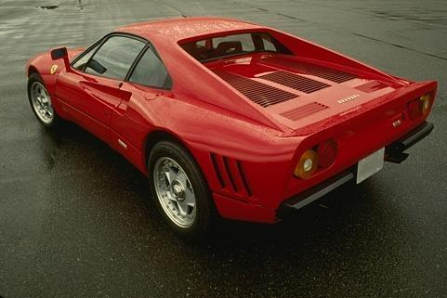
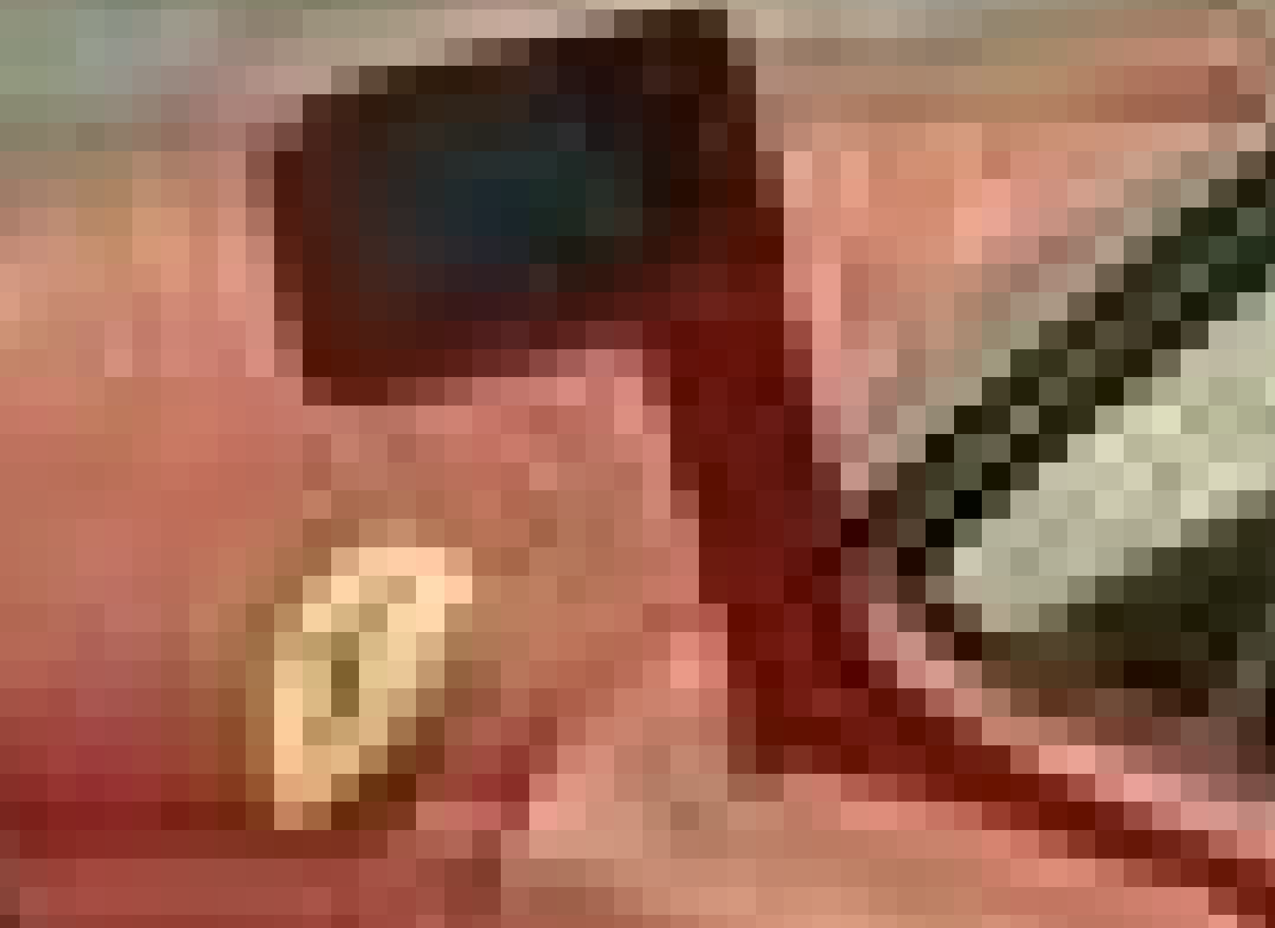
Discussion
some thinking from our side:
the BSDS500 dataset are already with jpeg compressed images, which might be the reason of bad performance in high quality compression.
Ground Truth image: A Ferrari Car
Details

Slide 22
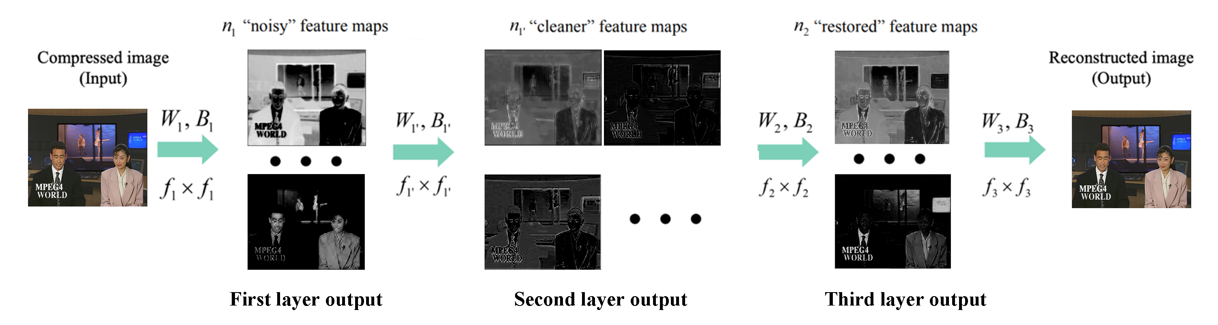
Discussion
some thinking from our side:
2. Function of second layer with f2 = 1?
3. The codec of still image is not exactly the same as the codec of video sequences.

Slide 23
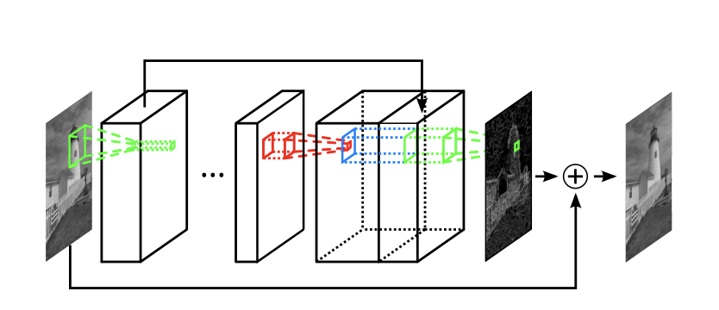
Second Attempt in Deep Learning
Improved structure with Residual Network

Slide 24
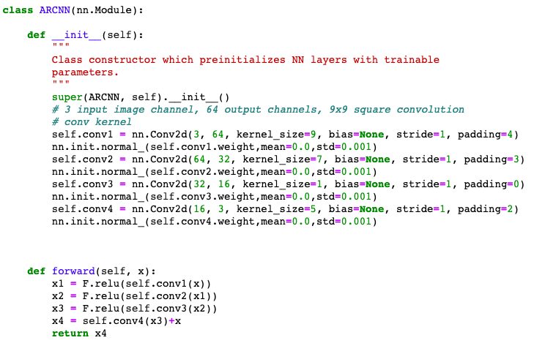

Code

Slide 25
Thanks for your attention
Xiajun Zhou
Zeen Song
München, 30. 07 2019

